Slide 1
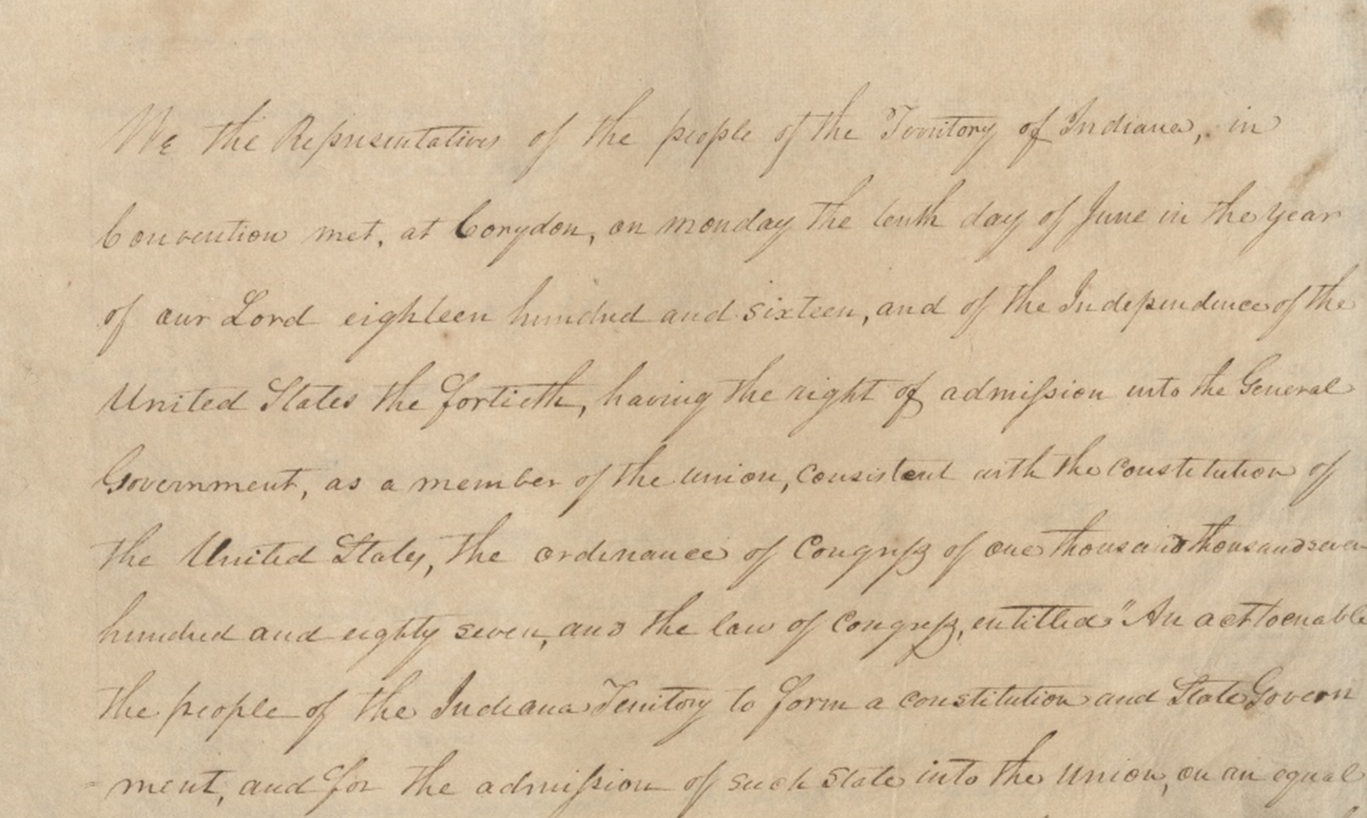

Public Records in Indiana

Slide 2
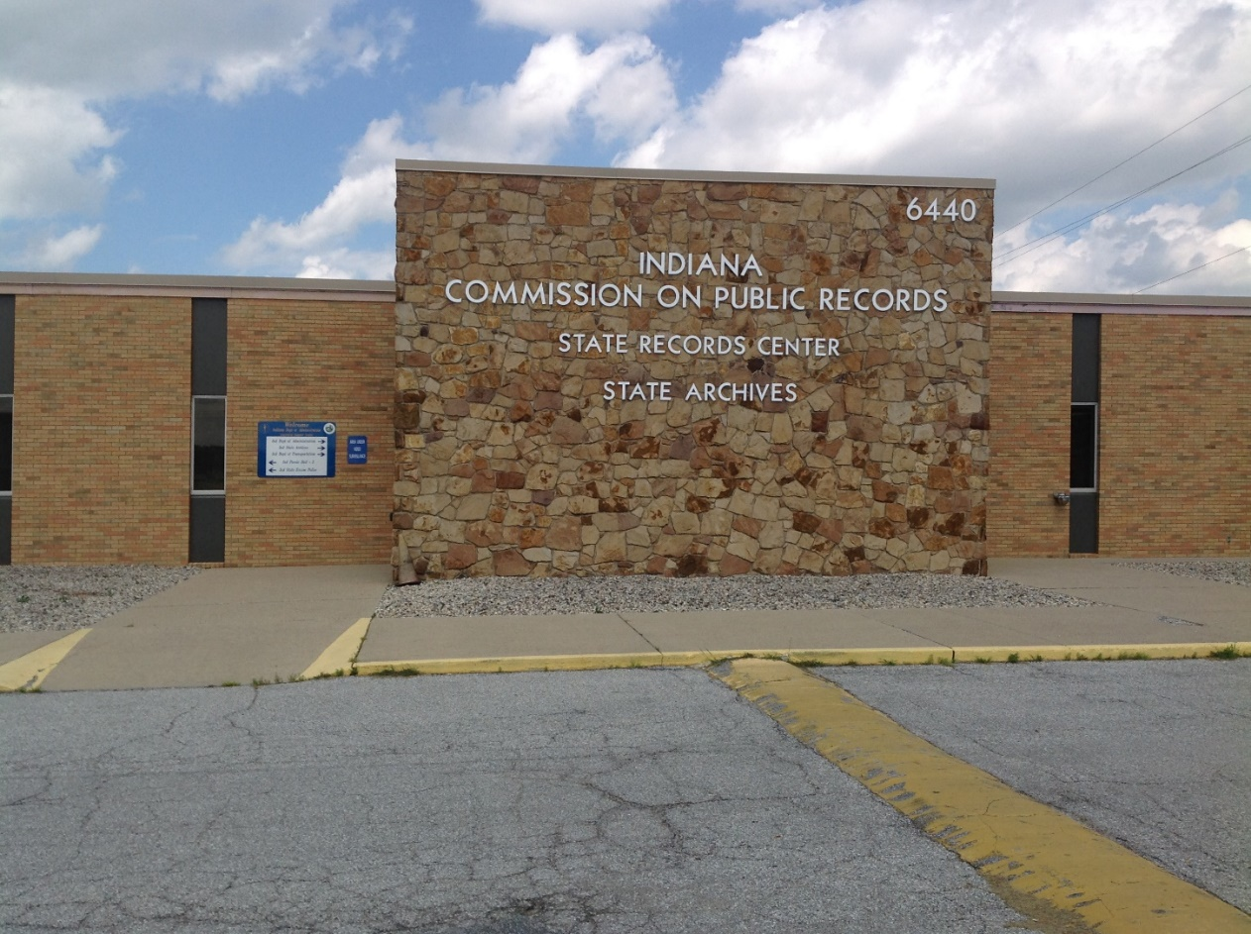
What is IARA?
Forms Management
Records Management
State Government
Local Government
Micrographics and Digital Imaging Lab
Records Center
State Archives
OCPR – Oversight Committee on Public Records
SHRAB – State Historic Records Advisory Board

Slide 3
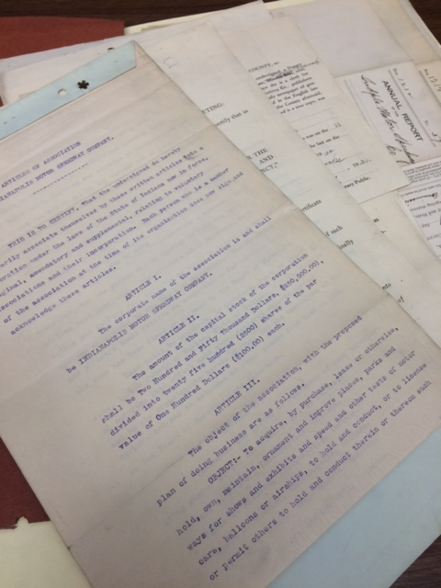
What is a Government Record?
“Any writing, paper, report, study, map, photograph, card, tape recording, or other material that is created, received, retained, maintained, used or filed by a public agency and which is generated on paper, paper substitutes, photographic media, chemically based media, electronically stored data, or any other material, regardless of form or characteristics.”
Notes:
Anything created or received during the transaction of official business
Public, confidential, and partially confidential

Slide 4
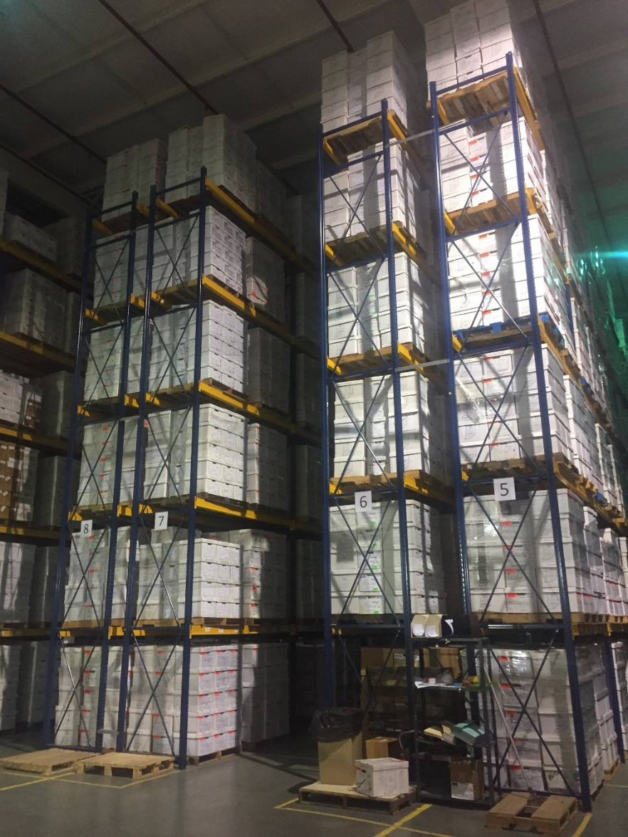
Government Records
What Does That Include?
Paper
Film and microforms
Website
Email
Data in a database
Born-digital records
Scanned/Digitized images
Audio files
Social Media
Metadata and Indexes

Slide 5
What is Records Retention?
How is the length of retention determined?
Generally, Records Management staff work with county/local offices utilizing established retention schedules to identify:
The Administrative and Fiscal value
Legal value
Public Demand and Interest, and
Historical value of the information
Paper, Film, Electronic
Retention is based upon content – NOT storage media

Slide 6
County & Local Government Records
Office Specific Schedules:
Assessing Official (AS)
County Auditor (AU)
County Clerk Non-Judicial (CL)
County Coroner (CO)
County Recorder (RE)
County Treasurers (TR)
County Prosecutor (PR)
Zoning, Planning , Development, Enforcement (LAND)
Public-Private Agreements (PPA)
Public & Charter Schools (ED)
Public Safety Agencies
The local retention schedules are available via: https://www.in.gov/iara/2739.htm.
Notes:
Make sure to note later the difference between Judicial and Non-Judicial County Clerk records.

Slide 7
County/Local General Retention Schedule (GEN)
This Retention Schedule is divided into five (5) categories: 1. Administrative 2. Accounting and Finance 3. Personnel 4. Publications and Reports 5. Audio, Video and General Media
GEN schedule is applicable to all offices in addition to their office specific Retention Schedule.
Retention periods for some records are increased in length of time to be retained because current Indiana Code statute of limitations have been applied to all records on this schedule.

Slide 8
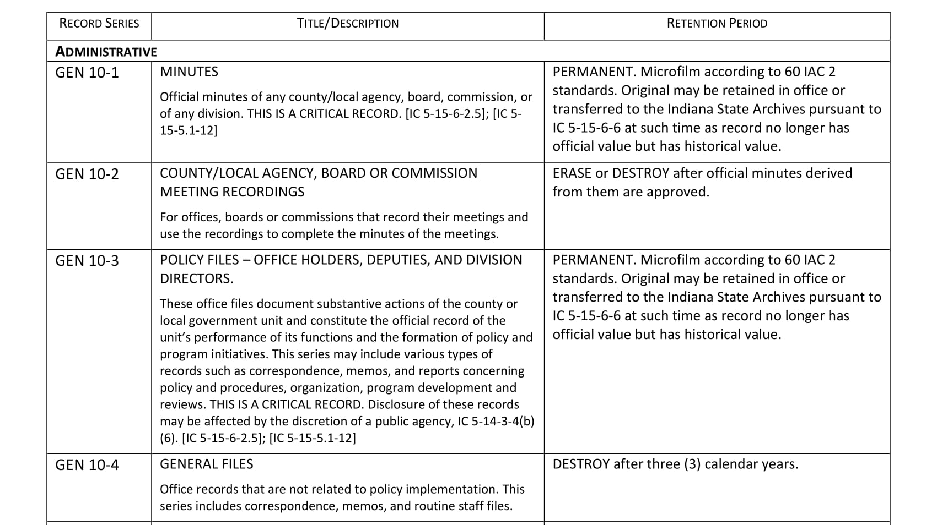
County/Local General Retention Schedule (GEN)
The local retention schedules are available via: https://www.in.gov/iara/2739.htm.

Slide 9
Other Local Schedules
City/Town/District Retention Schedules
Cities And Towns (CT)
Special Districts (SD)
Township Trustee (TT)
Other Local Retention Schedules
Public Libraries (LIB)
Education Institutions (EDA/EDS/EDC) (Public & Charter Schools)
Additional Retention Information
Year-to-Year Destruction Schedule
Judicial Records Retention Schedule – Administrative Rule #7
Notes:
Explain what Administrative Rule #7 is

Slide 10
IC 5-15-6 – Local Public Records Commissions (Membership)
IC 5-15-6-1 (b) The county commission shall consist, ex officio, of: (1) the judge of the circuit court or the judge's designee; (2) the president of the board of county commissioners or the president's designee; (3) the county auditor or the auditor's designee; (4) the clerk of the circuit court or the clerk's designee; (5) the county recorder or the recorder's designee; (6) the superintendent of schools of the school district in which the county seat is located or the superintendent's designee; and (7) either: (A) the city controller of the county seat city or the city controller's designee; or (B) if there is no city controller as described in clause (A), then the clerk-treasurer of the county seat city or town.

Slide 11
IC 5-15-6 – Local Public Records Commissions (Officers & Meetings)
The commission shall elect one (1) of its members to be chairman. The clerk of the circuit court or the county recorder must be secretary of the commission. The person who serves as secretary shall be determined as follows: (1) By mutual agreement of the clerk of the circuit court and the county recorder. (2) If a mutual agreement cannot be reached under subdivision (1), by an affirmative vote of a majority of members of the county commission. The commission shall provide to the administration the names and contact information for the chairman and secretary not later than thirty (30) days after the date of the determination. The members of the county commission shall serve without compensation and shall receive no disbursement for any expense.
(d) The county commission shall meet at least one (1) time in each calendar year. A quorum of 4 members is required for an official meeting.

Slide 12
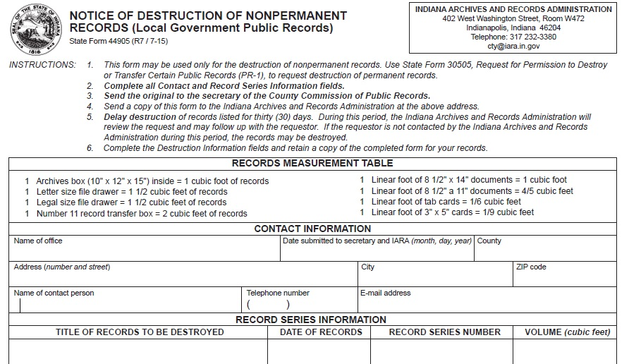
Notice of Destruction – SF 44905

Slide 13
Notice of Destruction – SF 44905
ALL SF 44905 NOTICE OF DESTRUCTION MUST CONTAIN RECORD SERIES INFORMATION.
The record series number is the number on the Retention schedule (left hand column) under which the record is listed
Example: Gen 10-10 - Receipts

Slide 14
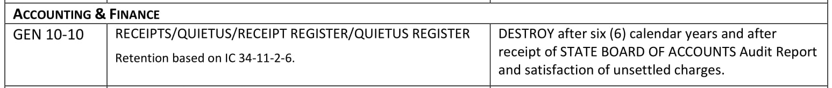
Notice of Destruction – SF 44905
Example: Gen 10-10 - Receipts
The local retention schedules are available via: https://www.in.gov/iara/2739.htm.

Slide 15
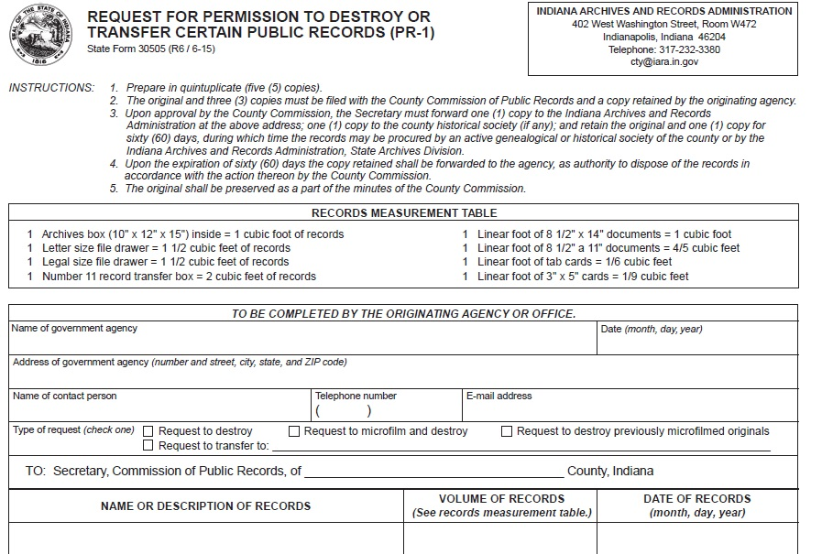
Request for Permission to Destroy or Transfer Certain Public Records – PR-1, SF 30505

Slide 16
Destruction of Records
It may be illegal to destroy government records if you do not have an approved records retention schedule or permission from your county commission of public records.
Indiana Law:
A public official may not mutilate, destroy, sell, loan, or otherwise dispose of any government record, except under a retention schedule or with the written consent of the administration (Archives & Records). IC 5-15-5.1-1-14
Notes:
Anything created or received during the transaction of official business
Public, confidential, and partially confidential

Slide 17
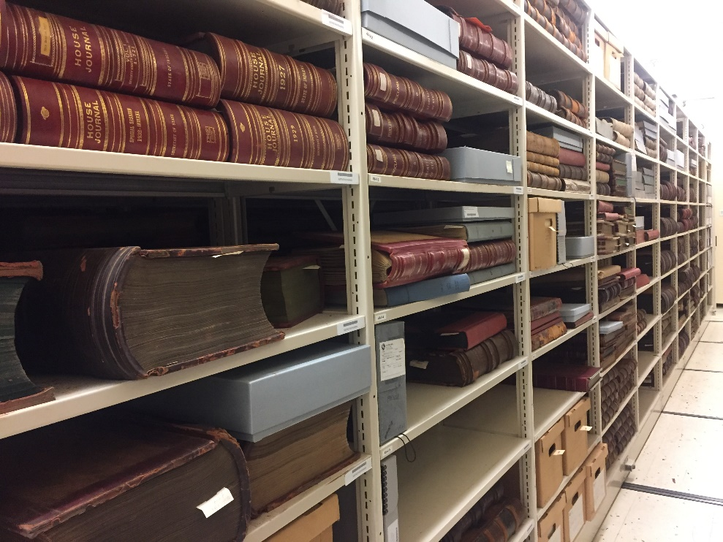
Retention Periods…
Transitory: can be destroyed immediately.
Short-term: generally ten years or fewer.
Long-term: greater than ten years and not permanent.
Permanent: forever.

Slide 18
Permanent Records
In many jurisdictions, you can only destroy permanent paper records if you MICROFILM the original paper records.
If you digitize Permanent records, or they are submitted electronically, they may also be REQUIRED to be converted to microfilm. Indiana’s Micrographics & Imaging Lab can assist! (https://www.in.gov/iara/2341.htm)
Digital records are generally NOT recognized as Permanent format to preserve information.

Slide 19
Records Projects
Indiana Archives Catalog – Research Indiana catalog is active. Includes state and local holdings from all three branches of government.
Barcoding all archives holdings.
Family Search and Ancestry Vital Records clean up project.
Developing a new system, Research Indiana Indexes, for online access.

Slide 20
Research Indiana Indexes
Collections Include:
Military
Veteran Graves Registry
Militia & Guard Records
Veteran’s Home
Civil War
Mexican War
WWI Gold Star & Book of Merit
Naturalizations
(Under Admin Rule 7 – All naturalization records should be sent to the Indiana State Archives.)
Institutions
State Hospitals
State Inmates
Deaf School
Soldiers and Sailors Children’s Home
Courts (State & County)
Additional Materials
Negro & Mulatto Registers
Dissolved Corporations
Indiana Public Lands

Slide 21
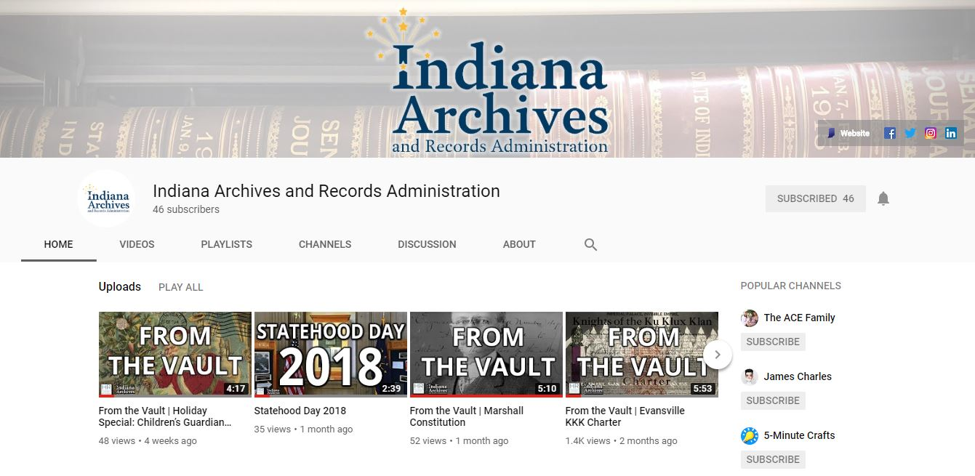
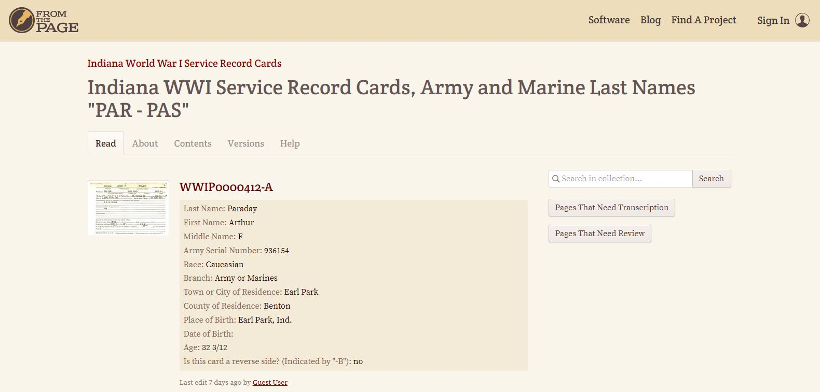
IARA Initiatives
From the Vault
Blog and Video Series
Social Media
Workshops
World War I Virtual Volunteer Project
Exhibits highlighting collections
Tours

Slide 22
IARA Local Records Website
https://www.in.gov/iara/2739.htm:
Specific to County/Local Records
Records Retention Schedules
Example of County E-Mail Retention Policy
Guide to Preservation and Destruction of Local Public Record
Forms (for county/local records)
County and Local Government Links
General Records Management
What is a Retention Schedule?
Publications
Laws
Links
Records Disaster Prevention and Reporting

Slide 23

Thank You!
bstiers@iara.in.gov
cty@iara.in.gov
317-232-3661

